Slide 1
Kofax VRS Elite: What is New?

Slide 2
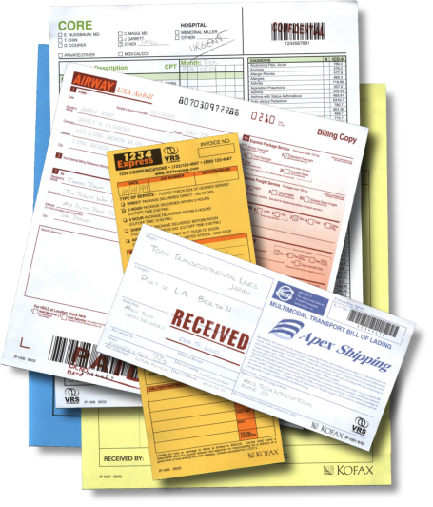
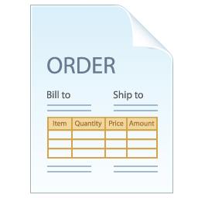
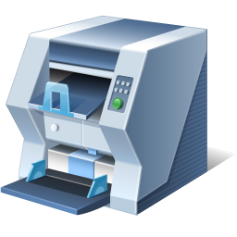
Kofax VRS Elite
Recognized industry standard for image perfection
Endorsed by leading document scanner manufacturers
Delivers perfect images the first time, every time
Notes:
Kofax VRS is the standard for Image Perfection technology. Kofax VRS ships with over 50% of the production document scanners sold in the industry. Every enterprise leveraging a document scanner probably has Kofax VRS installed or available to them. It is sold through our OEM relationships with Fujitsu, Kodak, Canon, HP, Visioneer, Xerox and others, and through our point of sales channel partners. Kofax VRS is a very powerful brand and core differentiator for Kofax as it shows Kofax has control from the time a document hits the feeder of the scanner. Kofax VRS is the first stop on the onramp to document driven business process automation. Kofax VRS improves scanning productivity by reducing the time involved in manual document preparation and automatically enhancing the quality of scanned images. The scanning process benefits from increased productivity, improved quality, lower costs, and a reduction in errors.

Slide 3
Value Proposition
Blind scanning: Kofax VRS Elite makes scanning smarter
Reduced document preparation: Just scan it…
Administrative control over entire scanner fleet
Perfect images the first time, every time
Notes:
Blind Scanning – as capture becomes more tightly coupled with core business processes, the users that are scanning documents are not considered scan operators. They are effectively knowledge workers whose main goal is to simply scan a document to initiate or close a transaction. Because Kofax VRS intelligently handles all the complexity of scanner settings, device connectivity, and image processing, the user is removed from this burden. This significantly increases the user acceptance of an imaging solution.
Reduced document preparation – all we ask is that you remove the staples and paper clips…Kofax VRS will do the rest. Kofax VRS will crop the document to the proper size, rotate images to the correct orientation, assign the proper settings to the document, and assist in the decision as to whether or not the image should be in color or black and white… Just feed the scanner and we will handle the rest. This significantly reduces document prep time, but more importantly greatly reduces the amount of user training and support. In many cases document preparation consumes over 30% of the overall process time.
Perfect images -

Slide 4
New Features and Capabilities

Slide 5
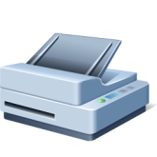
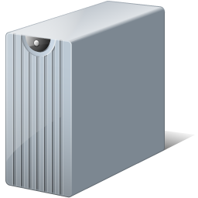
Kofax VRS Elite: Enterprise Capabilities
Simplified software deployment
Leverages MSI
Centrally controls distribution of Kofax VRS Elite
Reduces the deployment costs

Slide 6
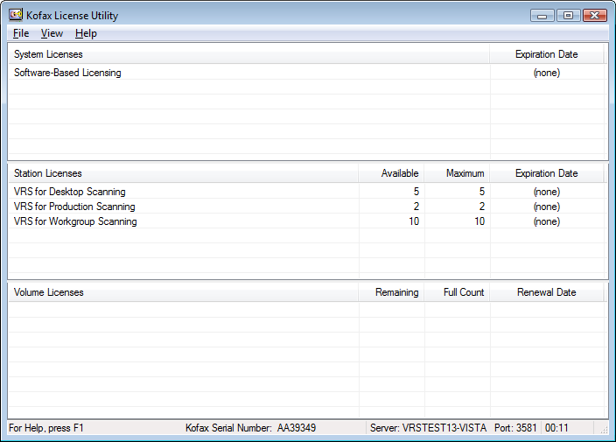
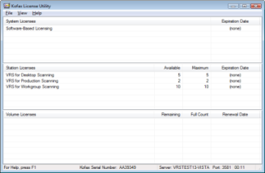
Kofax VRS Elite: Enterprise Capabilities
Centralized licensing
Centrally controls and distributes licenses
Makes Kofax VRS more appealing to enterprises
Reduces support costs and incidents
Notes:
Kofax VRS can now be licensed via the Kofax license utility (similar to Kofax Capture). This means that licenses can be maintained centrally and deployed the Kofax VRS stations as needed.

Slide 7
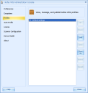
Kofax VRS Elite: Enterprise Capabilities
Central profile management
Ensures most current profiles are available
Administrator control over profile deployment
Improves Kofax VRS Elite performance

Slide 8
Shared Profiles / Training Data
Administrator can publish Kofax VRS profiles and training data from the Kofax VRS Administration Console
Publish “pushes” data to server
Clients “pull” data at runtime
Specific to scanner model

Slide 9
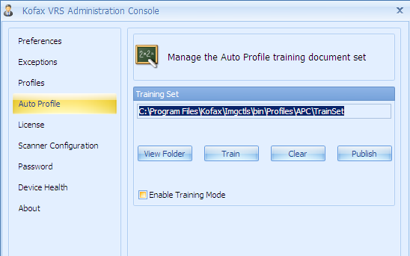
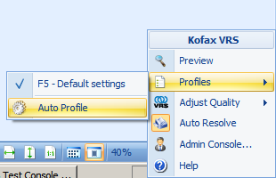
Auto Profile
Automatically applies correct profile at runtime
Train Kofax VRS Elite to apply profiles
Geometric form types
Learning mode enabled through Kofax VRS Administration Console
Confidence traps enable profile selection for images
Set threshold from Kofax VRS Administration Console
Enable Auto Profile from Kofax VRS Elite tray icon

Slide 10
Significance of Device Health
Trends
Capture is no longer just an archival use case
Scan to process is a key driver
Challenges
Quality of output is extremely important
ROI is calculated off of OCR/automation rates
Not dealing with scan operators

Slide 11
Kofax VRS Elite: Enterprise/Fleet Capabilities
Device Health: Proactive reporting of scanner effectiveness
Maximize scanner productivity
Proactively alert administrators of issues
SNMP support
Monitoring | Symptom
Stretched Images | ADF transport roller wear
Streaks | Contamination of optical path
Lamp Weakening | Failing lamps
Mispicks | Pick roller wear
Multi-feeds | Brake roller wear
Paper Jams | ADF roller wear

Slide 12
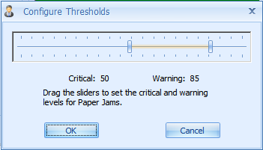
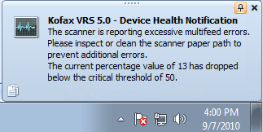
Kofax VRS Elite: Device Health
Kofax VRS Administration Console
Double-click to set thresholds
Critical notification

Slide 13
Kofax VRS Elite: Enterprise Capabilities
Kofax Monitor support
Monitors Kofax VRS Device Health
Sends proactive alerts to administrator
Enables more effective use of scanner fleet

Slide 14
Kofax VRS Elite: Kofax Monitor for Kofax VRS
Notes:
Kofax Monitor Dashboard

Slide 15
Core Improvements

Slide 16
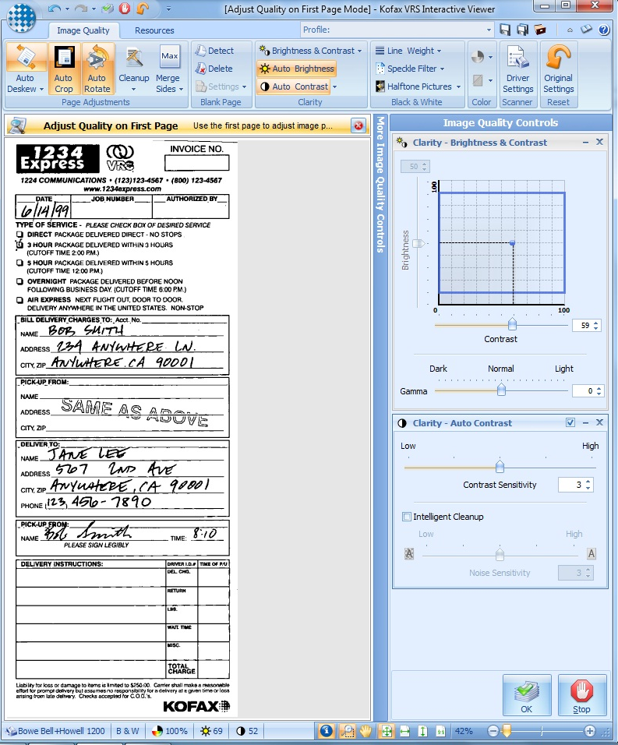
Usability
New Kofax VRS Elite UI
Customizable UI
User can dock frequently used features

Slide 17
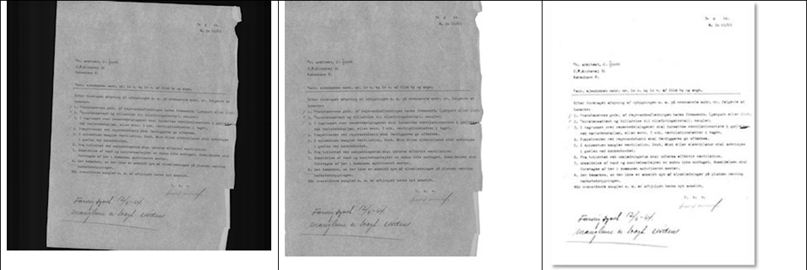
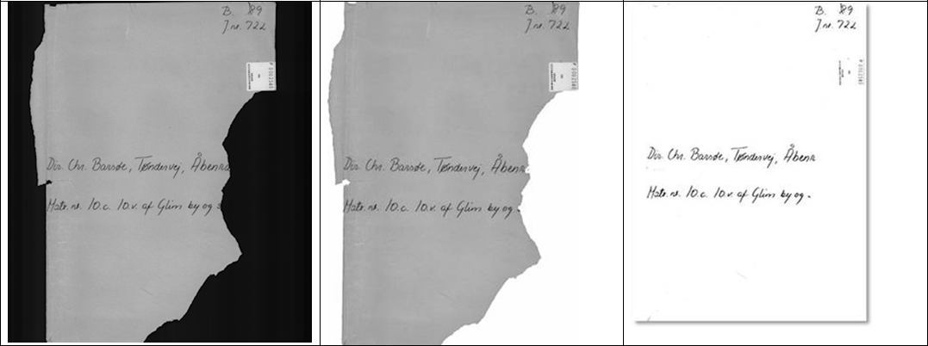
Corner Fill
Dog-eared corners
Irregular edges

Slide 18
Intelligent Halftone

Slide 19
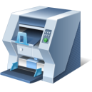
Multi-Core Kofax VRS Elite Processing
Master Image Input Queue
Image Processing Operation #1
Image Processing Operation #1
Image Processing Operation #1
Image Processing Operation #2
Image Processing Operation #2
Image Processing Operation #2
Image Processing Operation #3
Image Processing Operation #3
Image Processing Operation #3
Processed Image Output Queue (sorted by scan order)
Scanning Application

Slide 20
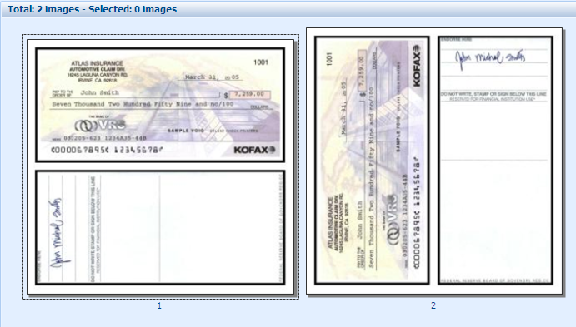
Merge
Merge both sides of a page into a single image
Automatically decides orientation based on document
Landscape – vertical orientation
Portrait – horizontal orientation

Slide 21
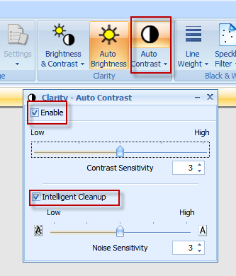
Advanced Clarity
Split into two features
Auto Contrast
Intelligent Cleanup

Slide 22
Other Features
Content based deskew – Updated
Rectangular hole fill
Manual crop
Expands Kofax VRS capabilities
Improves existing Kofax VRS features
Fits every use case: Desktop to Enterprise

Slide 23
Kofax VRS Version Feature Matrix

Slide 24
Kofax VRS Version Feature Matrix
Features | Elite | 4.5 Pro | 4.5 Basic
Crop | Upgraded | X | X
Deskew | Upgraded | X | X
Edge Cleanup | Upgraded | X | X
Auto Brightness | X | X | X
Gamma Correction | X | X | X
Line Filter | X | X | X
Speckle Removal | X | X | X
Advanced Clarity | Upgraded | X | N/A
Hole Fill | Upgraded | X | N/A
Auto Orientation | X | X | N/A
Auto Color Detection | X | X | N/A
Color Suppression | X | X | N/A
Color Smoothing | X | X | N/A
Blank Page Detection | X | X | N/A
Adrenaline | X | X | N/A
EBC Scanning | X | X | N/A
Microsoft Fluent UI | X | N/A | N/A
MSI Installer | X | N/A | N/A
Auto Contrast | X | N/A | N/A
Edge Fill | X | N/A | N/A
Merge Sides | X | N/A | N/A
Intelligent Halftone | X | N/A | N/A
Intelligent Profile | X | N/A | N/A
Device Health | X | N/A | N/A
Multi-core Support | X | N/A | N/A
Shared Profiles | Available with Kofax VRS Elite License Server | N/A | N/A
Shared Licensing |  | N/A | N/A
Kofax Monitor 6.0 |  | N/A | N/A

Slide 25
Kofax VRS Elite Pricing and Upgrades

Slide 26
Kofax VRS Elite Pricing: New Licenses
Add licenses to a Kofax VRS License Server by including the VP#L005-0000 on the order
Kofax VRS Elite parts on an order with a Kofax VRS Elite License Server will be added to that Kofax VRS Elite License Server system
Part Number | Description | List Price (per unit)
VP-D005-0001 | Kofax VRS Elite Desktop | $650
VP-W005-0001 | Kofax VRS Elite Workgroup | $1,450
VP-P005-0001 | Kofax VRS Elite Production | $2,450
VP#L005-0000 | Kofax VRS Elite License Server | $6,000

Slide 27
Kofax VRS Elite Pricing: Upgrades
Upgrade VRS 3.x or 4.x license to Kofax VRS Elite
Add upgrade licenses to a Kofax VRS License Elite Server by including the VP#L005-0000 on the order
Kofax VRS Elite upgrade parts on an order with a Kofax VRS Elite License Server part will be added to that Kofax VRS Elite License Server system
Part Number | Description | List Price (per unit)
UP-D005-0001 | Kofax VRS Elite Desktop Upgrade | $325
UP-W005-0001 | Kofax VRS Elite Workgroup Upgrade | $725
UP-P005-0001 | Kofax VRS Elite Production Upgrade | $1,225
VP#L005-0000 | Kofax VRS Elite License Server | $6,000

Slide 28
Kofax Training
Description | Part Number | List Price
Americas Classroom Training
Kofax Monitor 6 for VRS Elite Training & Certification Class | TR-4500-0001 | $1,000
CBT Training - Electronic Download
Kofax Monitor 6 for VRS Elite CBT & Certification | TR-4500-0260 | $1,000
VRS Elite CBT | TR-1500-0250 | $1,000
CBT Training - Physical Shipment
Kofax Monitor 6 for VRS Elite CBT & Certification | TR-4500-1260 | $1,000
VRS Elite CBT | TR-1500-1250 | $1,000
Live Online Training Courses
Kofax Monitor 6 for VRS Elite Training & Certification Class | TR-4500-0002 | $1,000
On-Demand Training Courses
Kofax Monitor 6 for VRS Elite On-demand Training & Certification | TR-4500-1560 | $1,000
VRS Elite On-demand Training | TR-1500-1550 | $1,000
Certification Exams
Kofax Monitor 6 for VRS Elite Certification Exam | TR-4500-0360 | $250

Slide 29
Thank You
Contact Kofax
http://www.kofax.com

